Slide 1


LARANA COMPANY
JULY 2025
SCIENCE
PROJECT
Department of EDA
Presented by Bassem Gamal

Slide 2

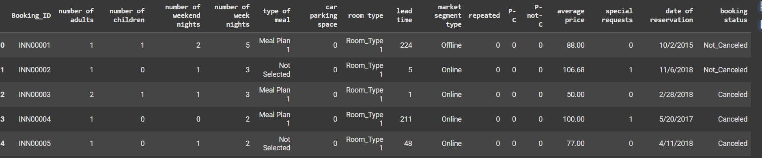
Data
Analysis
This dataset contains hotel booking records, including guest details, booking preferences, pricing, and final booking status (canceled or not). Each row represents a unique booking with features such as number of guests, nights stayed, meal plan, booking source, price, and special requests.

Slide 3
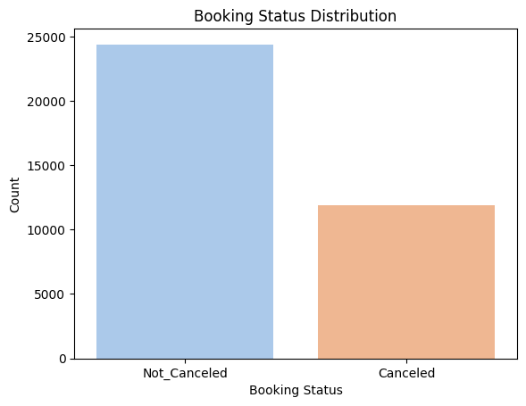
Data
Analysis
What is the distribution of booking status?
67.2% of bookings were not canceled.
32.8% of bookings were canceled.
Insight: Cancellations represent a significant portion of total bookings, highlighting a need to understand their causes.

Slide 4
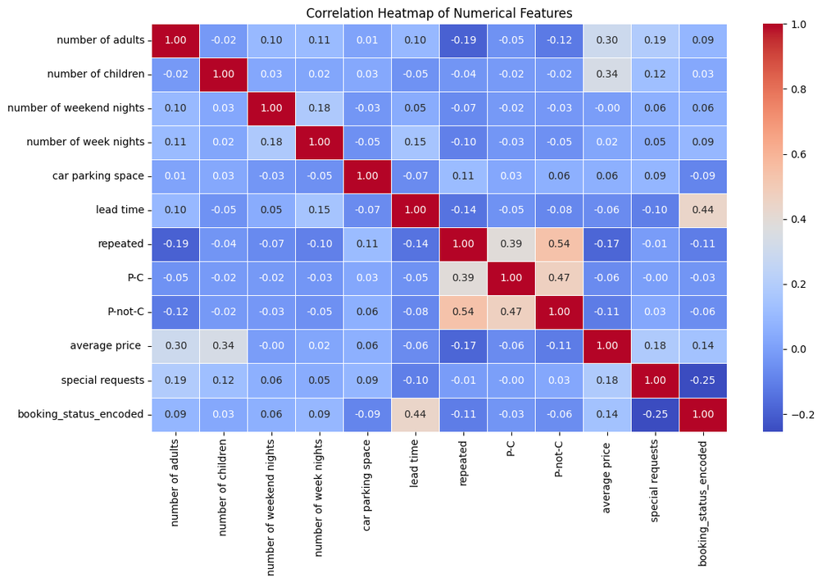
Data
Analysis
Which numerical variables are strongly correlated?
repeated is strongly correlated with P-not-C (r = 0.54) and P-C (r = 0.39)
number of children and average price show a moderate positive correlation (r = 0.34)
lead time is moderately correlated with booking_status_encoded (r = 0.44)
special requests has a negative correlation with cancellations (r = -0.25)

Slide 5
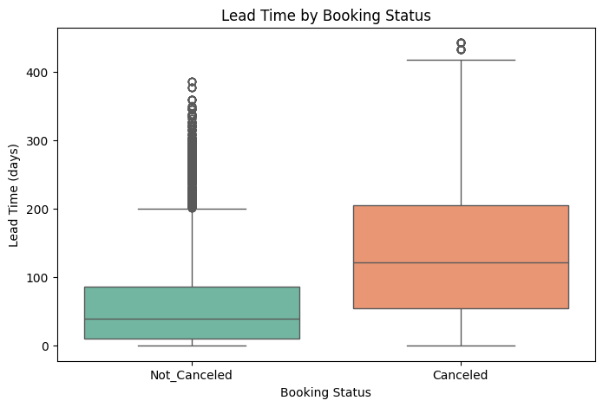
Data
Analysis
Does lead time affect booking cancellations?
Canceled bookings generally had a much longer lead time (booked far in advance).
Not canceled bookings had shorter lead times.
Insight: Guests who book earlier are more likely to cancel — possibly due to changing plans.

Slide 6
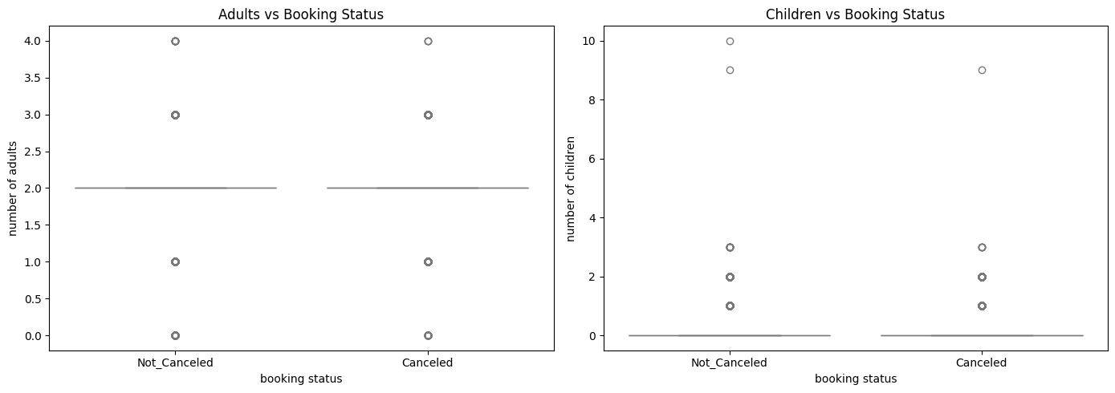
Data
Analysis
Do the number of adults or children impact cancellations?
No strong difference between canceled and not canceled bookings based on number of adults or children.
Insight: These features may not be strong predictors of cancellation behavior.

Slide 7
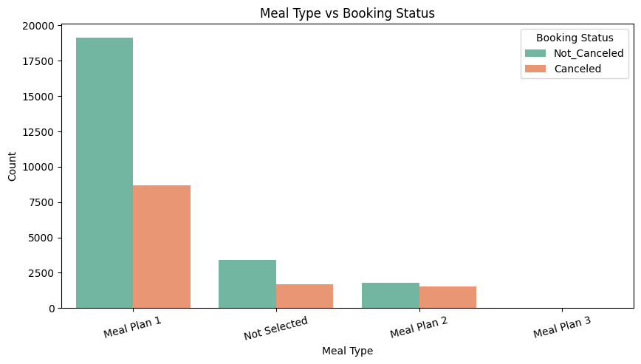
Data
Analysis
Is there a relationship between meal type and booking status?
Meal Plan 1 was the most common across all bookings.
Slightly higher cancellation ratios were observed with other meal plans.
Insight: While Meal Plan 1 is dominant, some variation exists that could be explored further.

Slide 8
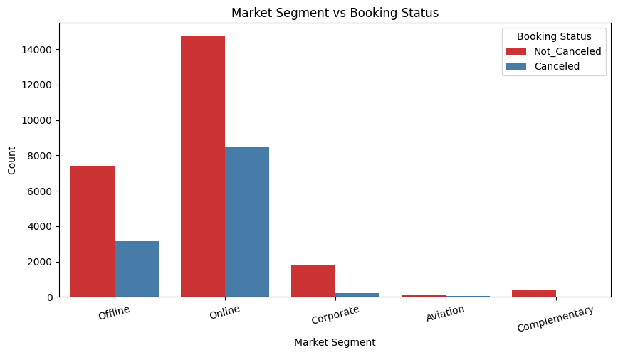
Data
Analysis
Does market segment affect cancellation rates?
Most cancellations came from the Online market segment.
Offline market had fewer cancellations.
Insight: Bookings made online may be more flexible or impulsive, resulting in higher cancellations.

Slide 9
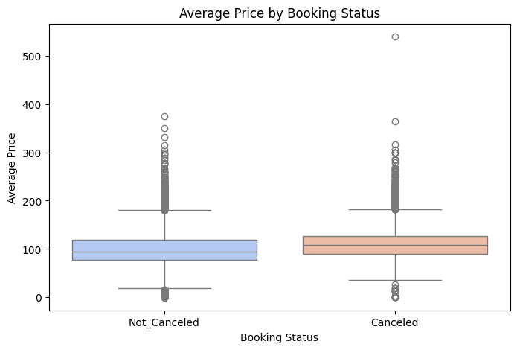
Data
Analysis
Does average price influence cancellation?
Canceled bookings tend to have slightly higher average prices.
However, there's a wide price range in both groups.
Insight: Price may play a role, but it’s not the sole factor.

Slide 10
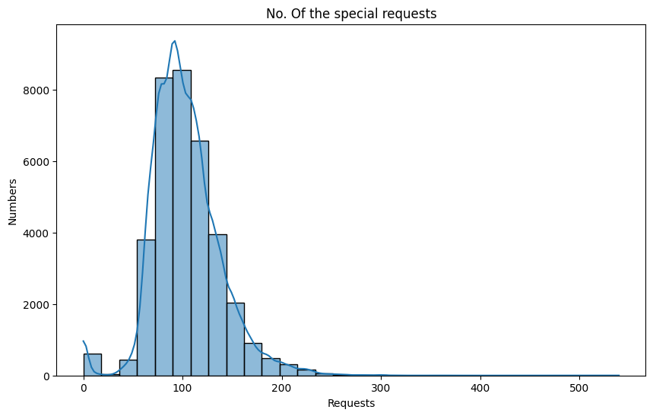
Data
Analysis
What is the distribution of the average price for hotel bookings?
The average price follows a right-skewed distribution, with most prices clustered between 80 and 130.
Very few bookings have an average price above 250.
The curve shows a peak near 90, suggesting it's the most frequent price range.

Slide 11
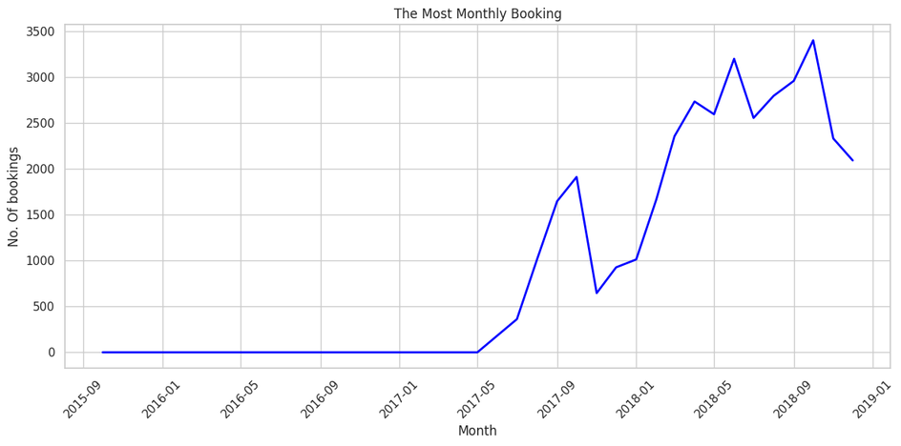
Data
Analysis
The line chart visualizes the total number of hotel bookings per month from 2015 to 2018.
Sharp increase started around mid-2017, peaking in late 2018.
Booking volume rose from nearly 0 to over 3000+ per month.
Seasonal fluctuations are visible, likely influenced by holidays and travel seasons.

Slide 12
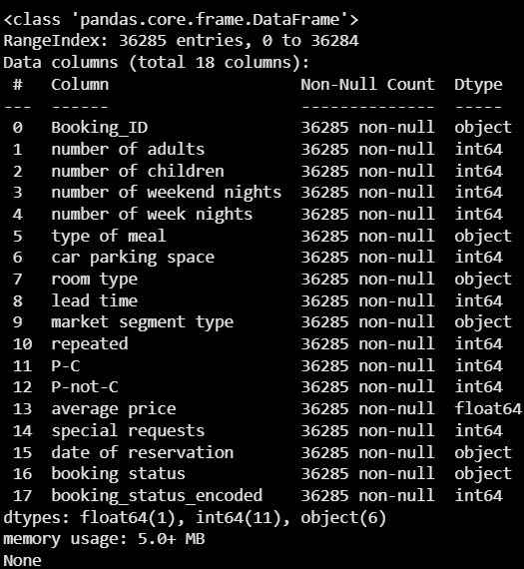
Data
Analysis
Total Rows: 36,285
Columns: 18
No missing values (great!)
Categorical Columns:
Booking_ID, type of meal, room type, market segment type, date of reservation, booking status
Date Column:
date of reservation (currently object, needs conversion)
Encoded Columns:
booking_status_encoded already exists — likely 0/1 for Canceled/Not_Canceled

Slide 13
Data
Analysis
Convert categorical (non-numeric) values into numerical format for machine learning algorithms.
Columns Encoded:
market segment type
Transformed from categories to numerical labels:
'Offline' → 0
'Online' → 1
'Corporate' → 2
'Aviation' → 3
'Complementary' → 4

Slide 14
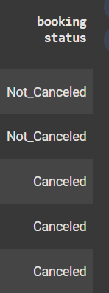
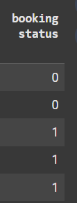
Data
Analysis
booking status
Transformed for binary classification:
'Canceled' → 1
'Not_Canceled' → 0
Why Encoding?
Machine learning models work with numbers, not strings.
Improves model accuracy by giving meaningful representation to categorical data.

Slide 15
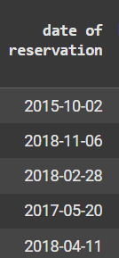
Data
Analysis
What Was Cleaned?
Invalid Dates in date of reservation
Problem: Some entries had incorrect dates (e.g., 2018-2-29, which is not a valid date).
Solution: Converted the column using pd.to_datetime() with errors='coerce' to handle invalid entries.
Changed date of reservation from text to datetime format to support time-based analysis:

Slide 16
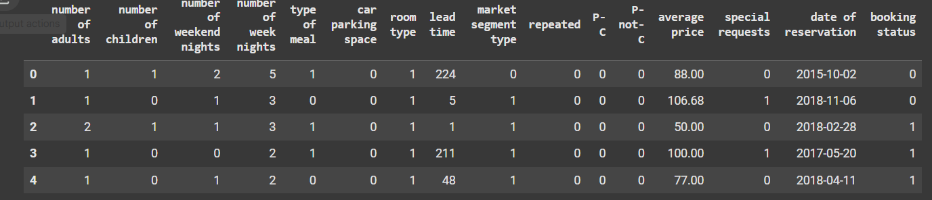
Data
Analysis
Dropped Non-Useful Column – Booking_ID
Booking_ID is unique for each record and doesn't help in modeling or analysis.
remove duplicate feature

